Slide 1
Chapter 6: Racial Profiling
Grant Morsberger

Slide 2
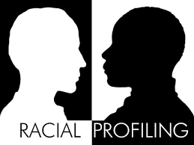
What is Racial Profiling?
By definition, Racial Profiling is the use of race or ethnicity as grounds for suspecting someone of having committed an offense.

Slide 3
Background: A difficult History
Continental Congress orders arrest of dozens of Quakers on the basis that they were supposedly disloyal to the cause. No hearings were held and no evidence was offered.
Pre- Civil War, African-Americans made up 1/6th of the United States population. Most were slaves, but those that were free were often still assumed to be slaves and some were sold back into slavery because courts at the time operated on the assumption that African-Americans were all slaves.

Slide 4
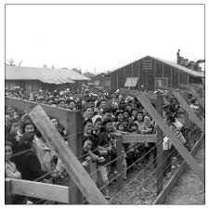
Background: Continued
During World War II, an estimated 110,000 Japanese people, most of whom were American citizens, were placed into internment camps, simply because they were Japanese. This is one of the largest scale incidents of blatant racial profiling on American soil.

Slide 5
Government Actions Regarding Racial Profiling: A Chronology
1968: Supreme Court issues limited stop and frisk authority.
1970: FBI develops “Profiles” of airplane hijackers and serial killers.
1975: Supreme Court allows use of race and ethnicity as grounds for stoppage at border checkpoints.
1980s: Racial Profiling emerges in the public as an issue.
1989: Supreme Court approves use of drug courier profiles.
1995: Maryland State Police agree to prohibit stops based on racial drug courier profiles.

Slide 6
Chronology Continued
1996: Supreme Court allows traffic stops even if real intent is drug enforcement.
1999: President Bill Clinton orders law enforcement agencies to gather race and ethnicity data to protect citizens against racial profiling.
2001: Muslims and Arabs face widespread public suspicion, singled out in public transportation safety checks.
2003: Racial and ethnic profiling is banned in all federal law enforcement agencies, with the exception of national security related investigations.

Slide 7
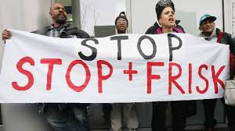
Chronology Continued
2013: NYPD found guilty of racial profiling and Fourth Amendment violations in regard to stop and frisk policies.

Slide 8
Pressure for Change
NAACP representative calls for police forces to re-examine their use of force policies.
Federal guidance prompted by President Obama to help departments institute the use of body cameras by all officers. Not yet a federal mandate.
Calls for banning of military-style equipment to local police forces, especially after the use of the equipment during the unrest in Ferguson, after the shooting death of Michael Brown.

Slide 9
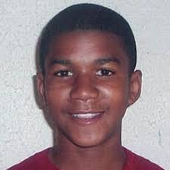
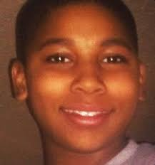
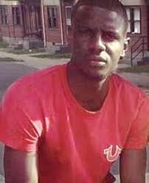
Modern Examples of Racial Profiling
Trayvon Martin
Tamir Rice
Freddie Gray

Slide 10
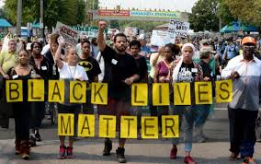
Black Lives Matter
Black Lives Matter, or BLM, is a protest movement meant to highlight and protest the injustices towards blacks by police, often because of racial profiling. The movement was born shortly after Michael Brown was killed in 2014.

Slide 11
Outlook
How do the Police and Government regain the people's trust?
Police departments must step outside traditional policing and become more of a social actor in communities.
We need progressive thoughtful leaders that will listen to what people say and make significant changes to policing as a whole.

Slide 12
Image Sources
Image Sources Cited
“Death of Freddie Gray.” Wikipedia, Wikimedia Foundation, 2 Oct. 2018, en.wikipedia.org/wiki/Death_of_Freddie_Gray.
Gottfried, Mara H., and Jaime DeLage. “Mark Dayton: Black Lives Matter's 'Pigs' Chant a 'Terrible Thing to Say'.” Twin Cities, Twin Cities, 28 Oct. 2015, www.twincities.com/2015/09/01/mark-dayton-black-lives-matters-pigs-chant-a-terrible-thing-to-say/.
Herman, Anna. “Does Racial Profiling Affect Criminal Charges.” Jacqui Ford Law, Admin Https://Fordlawokc.com/Wp-Content/Uploads/2017/03/Logo-Dk-Teal.png, 28 Mar. 2017, fordlawokc.com/does-racial-profiling-affect-criminal-charges/.
“Japanese Internment Camps.” Childhood Left at the Station: A Tribute to the Children of the Kindertransport - Los Angeles Museum of the Holocaust, www.lamoth.org/visitor-information/guide-to-the-museum/museum-panels/room-3-war-ghettoization-exter/japanese-internment-camps/.
Jr., Richard A. Oppel. “Cleveland Mayor Apologizes for Language Used to Blame Tamir Rice for His Death.” The New York Times, The New York Times, 21 Dec. 2017, www.nytimes.com/2015/03/03/us/cleveland-mayor-apologizes-for-language-used-to-blame-tamir-rice-for-his-death.html.
“NYPD's 'Stop, Question and Frisk' Policy Is Racial Profiling,Critics Say.” CNN, Cable News Network, 3 Apr. 2012, inamerica.blogs.cnn.com/2012/04/03/nypds-stop-question-and-frisk-policy-is-racial-profilingcritics-say/.
“Trayvon Martin.” Biography.com, A&E Networks Television, 1 Aug. 2018, www.biography.com/people/trayvon-martin-21283721.

Slide 13
Q1: Is there a federal mandate requiring police officers to wear body cameras?A1: No, the body camera decision remains up to the states discretion.
Q2: Did the Supreme Court allow the use of Drug Courier Profiles?
A2: Yes, the use of Drug courier profiles is deemed constitutional.
Q3: What was the largest example of Racial Profiling in the last Century?
A3: Japanese Interment camps.

